Slide 1
Cloud at Customer Academy 3.0
Exadata Cloud - Backup & Restore
Marcel Lamarca Alexandre Fagundes
Licenses and Systems OCI Databases & App’s DBA
LAD Partner Enablement Knowledge Team August, 2023

Slide 2

Nossos Valores
Como empresa líder em tecnologia, abraçamos a diversidade em todas as suas formas. Acreditamos realmente que a inovação começa com a inclusão. E isso só pode ser alcançado com a cooperação de nossos parceiros. Afirmamos nosso compromisso em manter um ambiente respeitoso e livre de discriminação e esperamos isso dos nossos parceiros de negócios.
A Oracle espera que seus parceiros conduzam os negócios de forma justa e ética, para cumprir as leis anticorrupção em todo o mundo, para cooperar com os pedidos de informação da Oracle e evitar envolver-se em qualquer atividade que envolva até mesmo a aparência de impropriedade.
É vital que os nossos parceiros sejam aderentes aos valores do Código de Ética e Conduta Empresarial da Oracle, que baseia-se e implementa os valores que são essenciais para o nosso sucesso como empresa. Nossos valores são a base de tudo o que fazemos e todos nós devemos viver esses valores todos os dias.
Integridade
Ética
Compliance
Inovação
Trabalho em Equipe
Respeito Mútuo
Satisfação do Cliente
Justiça
Qualidade
Comunicação
Utilize o QR code para acessar o Código de Ética e Conduta Empresarial da Oracle.

Slide 3


SQL> select * from person where name = ‘Marcel Lamarca’
Father, husband, Cooker and son!
Graduated in Business Administration (FMU-SP)
Oracle DBA
21 Years dedicated to study and support Oracle Databases.
12 Years working with Exadata (On-prem, C@C and Cloud Services) .
4 Year working for Oracle do Brasil
1 Year on Alliances LAD knowledge Team
Oracle Cloud Specialist (OCS)
Exadata Database Machine X9M Certified Specialist
OCI Foundation 2020 / 2023
Oracle Autonomous Database Administrator
Oracle Cloud Database Migration and Integration
OCI Cloud Certified Architect Associate 2022
OCI Cloud Certified Architect Professional 2022
Oracle Certified Professional (OCP)
10g, 11g and 12c.
Oracle Certified Specialist (OCE)
Grid/RAC Database Administrator 11g

Slide 4


SQL> select * from person where name = ‘Alexandre Fagundes’
 | Father, Son, Husband, Cloud Architect
 | Bachelor of Information Systems Oracle Applications & Databases Administrator Certified Cloud Architect Autonomous Database Cloud Certified Professional Oracle Cloud Operations Certified Professional Oracle Cloud Security Certified Professional Oracle Database Migration/Integration Certified Professional
 | Last book: “Database Reliability Engineering: Designing and Operating Resilient Database Systems” Charity Majors
 | Oracle E-Business Suite & Database Consultancy Services since 2002

Slide 5
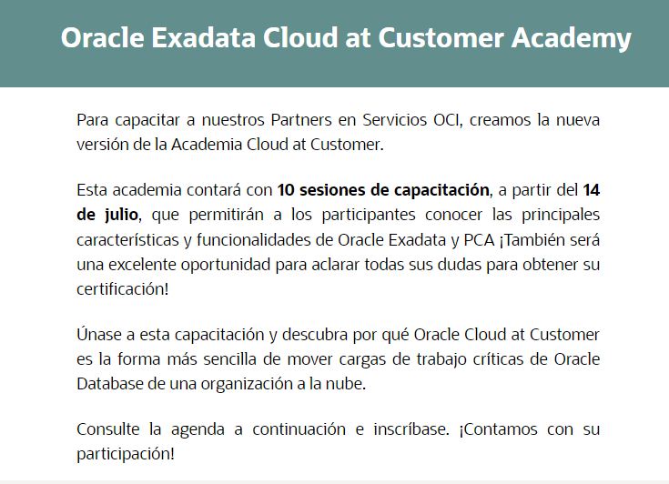
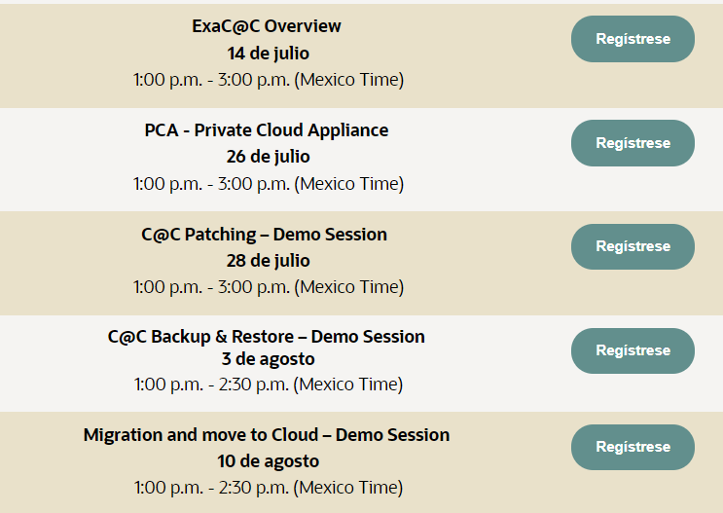
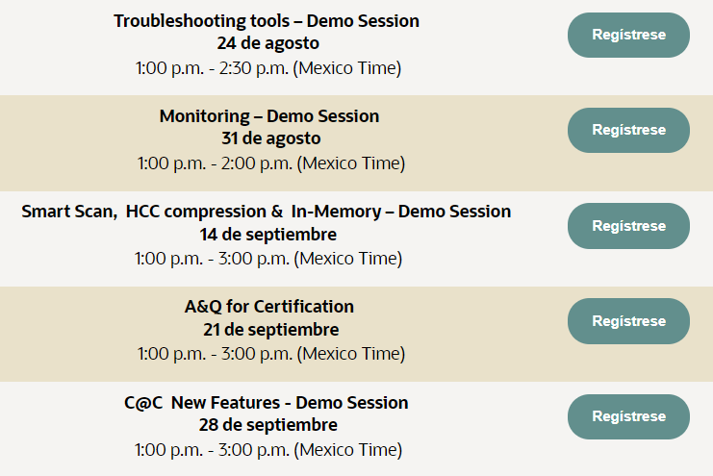
Exadata Academy 3.0 | Register Now
Click Here

Slide 6


ExaC@C Storage Backup Options
OCI Automatic Backups
ExaC@C Backup and Restore Tools
Agenda
Oracle RAC and Security Backups
ExaC@C Backup Networks
Demo – Enabling Blocking Change Tracking
Demo – Creating backup destination OC
Demo – Backup ExaCC via dbaascli

Slide 7


Why Backup and protect my data?

Slide 8



Data protection goals in the cloud
Minimize ransomware risk | Optimize operations | Reduce administration
Reduce data loss exposure and downtime after an attack | Get rid of time-consuming and resource-intensive weekly full backups on production database services | Consistently apply backup policies across an organization
Protect against backup deletion or alteration during an attack | Eliminate backup validation resource consumption on production database services | Understand backup health and recoverability
Secure backups against unauthorized access and information disclosure | Simplify multistep recovery processes and make recovery times predictable | Plan for database backup space utilization
 | Minimize backup-driven costs
Notes:
So, what should your goals be for data protection in the cloud. These are general goals, but we’ll apply them specifically to database environments.
You need to minimize ransomware risk.
Data protection can’t prevent an attack, but it can protect your data and help you recover quickly if one should occur.
You need to optimize operations.
This allows you to make sure that growing database sized don’t exceed your ability to protect them. It also can help you reduce consumption on database services and automate protection – all of which lower costs
And you need to reduce administration while also providing consistent protection across your organization, knowing that your databases are protected, and planning for cost-effective support of your backup operations.

Slide 9
Exadata C@C MAA Overview

Slide 10
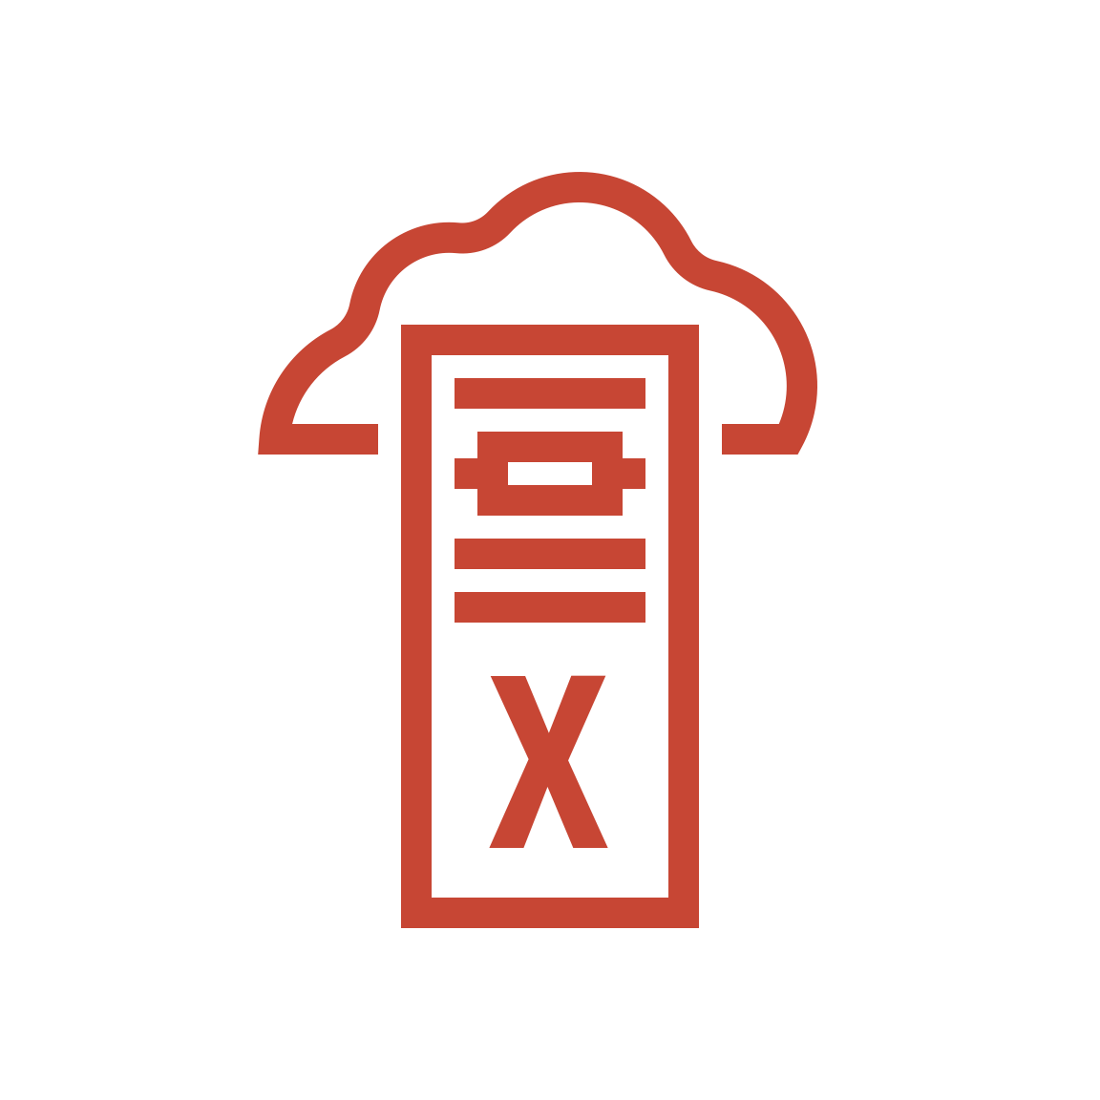







Oracle Maximum Availability Architecture (MAA)
High-Availability Blueprint in the Cloud
Primary Cloud Region
Secondary Cloud Region
Data Guard (redo transport)
Cloud Backup
Primary (Redundant HW/SW)
Remote Standby (Disaster Recovery)
Key Cloud MAA Technologies
Continuous availability
Data protection
Active replication
Scale out
Application Continuity
Global Data Services
Flashback
RMAN
Active Data Guard
GoldenGate
RAC
ASM
Sharding
Notes:
A key feature of Exadata Database Service is Oracle best practices are built-in. You no longer need to comb over technical briefs and documentation to figure out how be deploy your database for best performance, availability, and security. Just deploy using the cloud automation, and your system will be optimally configured to provide the highest service levels. It automatically deploys Oracle RAC, to provide a scalable, highly available database tuned to run on the Exadata platform. Oracle RAC protects from unplanned failures by spreading work across multiple database instances. In addition, it eliminates downtime for maintenance activities by automatically migrating work off the servers about to undergo maintenance to others that remain online. Also, backups and replication with Data Guard can be easily configured for disaster recovery using the Control Plane. In fact, Exadata Database Service supports all the Oracle Maximum Availability (MAA) technologies, which form the high-availability blueprint for Oracle databases in the cloud.

Slide 11
Exadata C@C Backup Destinations

Slide 12
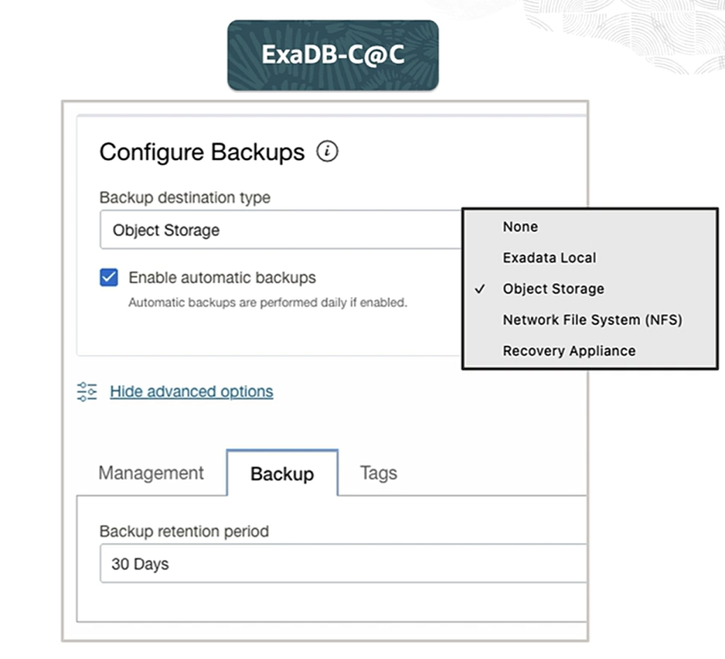
Exadata C@C Database backup available destinations
Chose the best backup destination for your databases
Zero Data Loss Recovery Appliance (ZDLRA)
NFS Storage
Exadata Local Storage
Object Storage
None

Slide 13
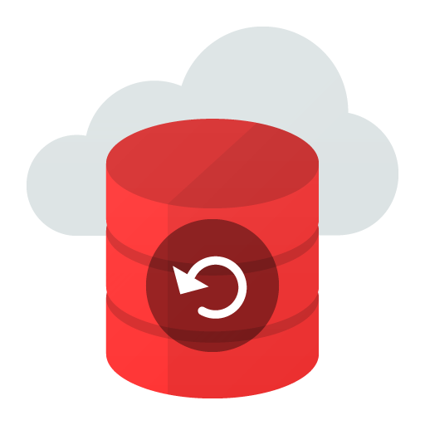




Prerequisites for Backup Exadata Cloud at Customer : NFS
You must mount the NFS server location to a local mount point directory on each node in the VM Cluster
The local Directory patch and the NFS Server location must each be the same across all the VM Cluster nodes
You must ensure that the NFS mount is maintained continuously on all the VM cluster Nodes.
The NFS-Mounted file system must be readable and writable by the Oracle Operation System user on all the VM Cluster Nodes
Encrypted Databases
Network
File System
(NFS)

Slide 14
Prerequisites for Backup Exadata Cloud at Customer : ZDLRA
The appliance must be configured with a virtual private catalog (VPC) user with is used for taking backups.
The appliance must be configured with the unique database name of the database being backed up, and a mapping to the VPC user.
The appliance must be accessible from the Cloud@Customer system using the Oracle Net Services connection string with is provided by the Zero Data Loss Recovery Appliance
Encrypted Databases
ZDLRA
Appliance

Slide 15
Prerequisites for Backup Exadata Cloud at Customer : Object Storage
You must be granted security access in the AIM Policy
Must have connectivity for the Exadata Cloud to the Object Storage Service
Oracle recommends using a Service Gateway with The VCN to enable this Access
Encrypted Databases
OCI
Object Storage
Notes:
As an operations manager, or potentially even a compliance person, you want to know whether your databases are protected.
In normal operations, these are defined by the database and not collected into a central location. With the Recovery Service, you get to see the status of all of the protected databases in your OCI Compartment. Showing whether real-time protection is enables, potential data loss exposure, recovery window, capacity used, and protection policy.
A few more words on the last two.
The service comes with several predefined protection policies that specify length of retention. You can also create your own. The “Finance” database we were looking at in the previous screen is the first one on this line and you can see that it has Bronze retention of 14 days (although it hasn’t been created that long ago), has zero data loss enables and actually has zero data loss exposure. If that data loss exposure was more than zero on the “Finance” database, we would have to look into why.
This view also shows the entire amount of storage consumed by the database backups, logs, etc. This will continue to go up until slightly after the 14 day recovery window is reached. However, what if you’re planning future consumption? It’s not shown here, but the Recovery Service also includes a planning tool that will allow you to model what your consumption will likely be and plan accordingly.

Slide 16
Prerequisites for Backup Exadata Cloud at Customer : Local Storage
You can configure your database to store Rman backups on database FRA area ASM (+RECO Disk Group)
All Exadata Cloud at Customers uses ASM Triple mirror redundancy policy
If you chose local backup destinations, you must disable automatic backups on OCI console
You must use dbaascli tool to configure manual backups on local storage
Encrypted Databases
FRA
Local Storage
Notes:
As an operations manager, or potentially even a compliance person, you want to know whether your databases are protected.
In normal operations, these are defined by the database and not collected into a central location. With the Recovery Service, you get to see the status of all of the protected databases in your OCI Compartment. Showing whether real-time protection is enables, potential data loss exposure, recovery window, capacity used, and protection policy.
A few more words on the last two.
The service comes with several predefined protection policies that specify length of retention. You can also create your own. The “Finance” database we were looking at in the previous screen is the first one on this line and you can see that it has Bronze retention of 14 days (although it hasn’t been created that long ago), has zero data loss enables and actually has zero data loss exposure. If that data loss exposure was more than zero on the “Finance” database, we would have to look into why.
This view also shows the entire amount of storage consumed by the database backups, logs, etc. This will continue to go up until slightly after the 14 day recovery window is reached. However, what if you’re planning future consumption? It’s not shown here, but the Recovery Service also includes a planning tool that will allow you to model what your consumption will likely be and plan accordingly.

Slide 17
OCI Database Automatic backups

Slide 18
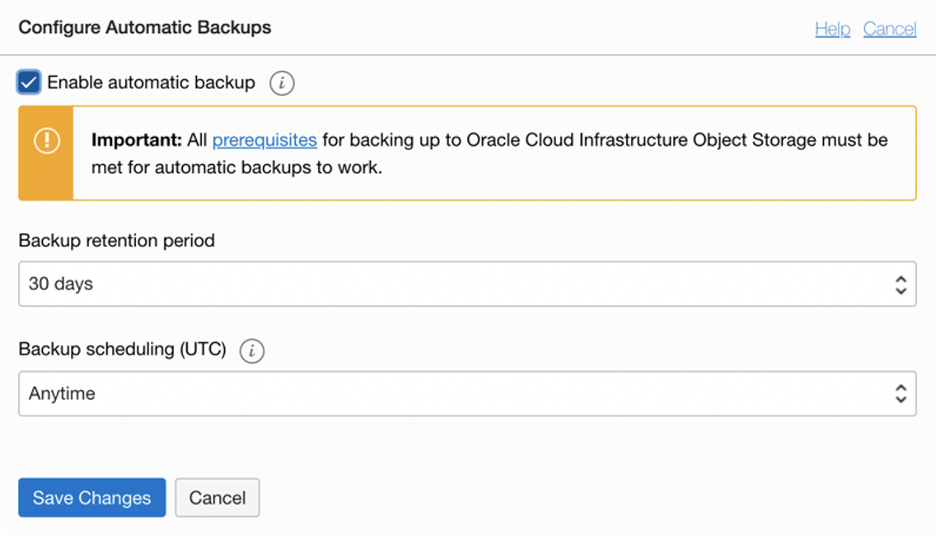
Automatic Database backup Using the OCI Console
Enable Automatic Incremental backups
View the list of managed backups for a database
Create full backups on demand is not allowed on Exadata @Customer
Backup data is always automatically encrypted using Transparent Data Encryption
Do not delete any necessary encryption keys from the wallet or vault because this causes database and backup protected by the key to become unavailable
Notes:
As an operations manager, or potentially even a compliance person, you want to know whether your databases are protected.
In normal operations, these are defined by the database and not collected into a central location. With the Recovery Service, you get to see the status of all of the protected databases in your OCI Compartment. Showing whether real-time protection is enables, potential data loss exposure, recovery window, capacity used, and protection policy.
A few more words on the last two.
The service comes with several predefined protection policies that specify length of retention. You can also create your own. The “Finance” database we were looking at in the previous screen is the first one on this line and you can see that it has Bronze retention of 14 days (although it hasn’t been created that long ago), has zero data loss enables and actually has zero data loss exposure. If that data loss exposure was more than zero on the “Finance” database, we would have to look into why.
This view also shows the entire amount of storage consumed by the database backups, logs, etc. This will continue to go up until slightly after the 14 day recovery window is reached. However, what if you’re planning future consumption? It’s not shown here, but the Recovery Service also includes a planning tool that will allow you to model what your consumption will likely be and plan accordingly.

Slide 19
Automatic Backups for Exadata Database Service Characteristics
Database Backup occur daily
Archived redo log files are backed up every 30 minutes for ExaDB-C@C
There is a 7-day backup cycle:
With one full backup
And daily incremental backups
The default retention period is :
30 days for backups to cloud object storage or NFS
7 days for backup to local Exadata storage
Assigned ZDLRA Backup Policy will determine the retention period
For database deployments with Oracle Data Guard, automatic backups are always executed on the original primary site
Notes:
As an operations manager, or potentially even a compliance person, you want to know whether your databases are protected.
In normal operations, these are defined by the database and not collected into a central location. With the Recovery Service, you get to see the status of all of the protected databases in your OCI Compartment. Showing whether real-time protection is enables, potential data loss exposure, recovery window, capacity used, and protection policy.
A few more words on the last two.
The service comes with several predefined protection policies that specify length of retention. You can also create your own. The “Finance” database we were looking at in the previous screen is the first one on this line and you can see that it has Bronze retention of 14 days (although it hasn’t been created that long ago), has zero data loss enables and actually has zero data loss exposure. If that data loss exposure was more than zero on the “Finance” database, we would have to look into why.
This view also shows the entire amount of storage consumed by the database backups, logs, etc. This will continue to go up until slightly after the 14 day recovery window is reached. However, what if you’re planning future consumption? It’s not shown here, but the Recovery Service also includes a planning tool that will allow you to model what your consumption will likely be and plan accordingly.

Slide 20
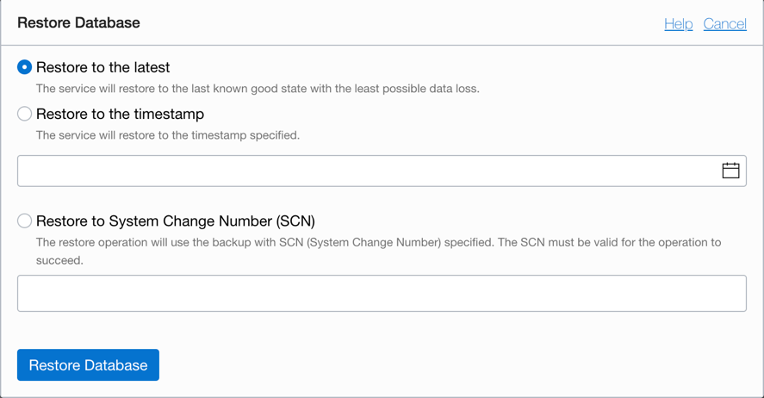
Restoring Database from OCI Automatic Backup
You can recover your database up to 3 options
Lasted point of fail or database unavailability
To a specific timestamp
Up to a specific System Change Number (SCN)

Slide 21
Cloud Backup and Restore Tools

Slide 22

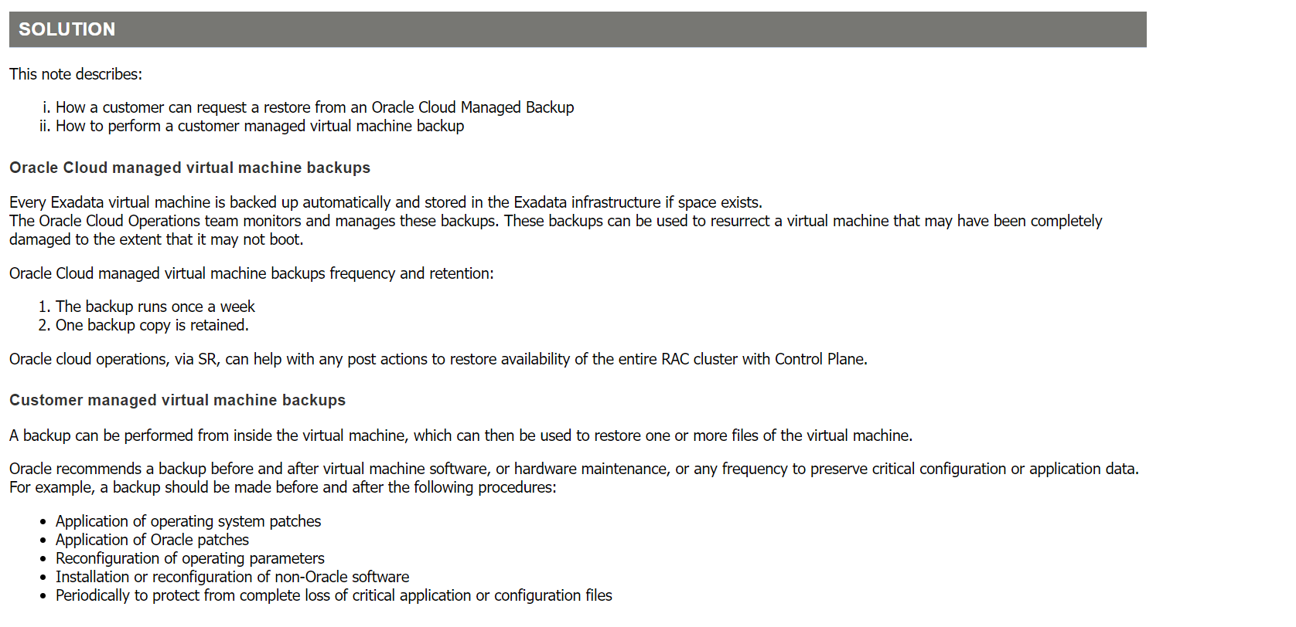
Exadata Cloud Compute Node Backup and Restore Operations MOS Note: 2809393.1
Copyright © 2023, Oracle and/or its affiliates. All rights reserved

Slide 23
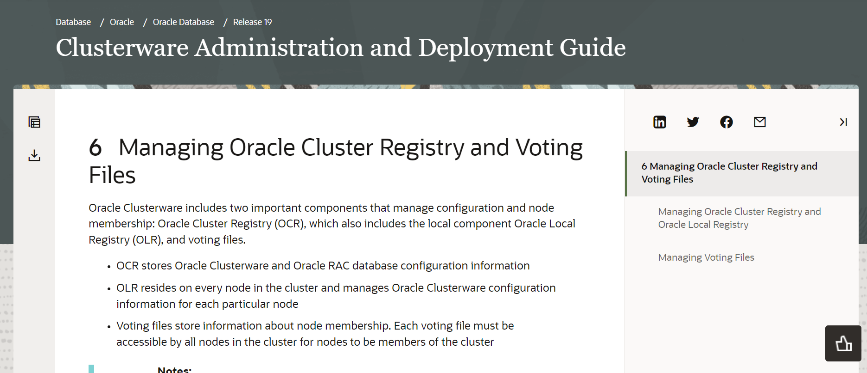
Don’t Forget to Backup your OCR Register and Voting Files
Copyright © 2023, Oracle and/or its affiliates. All rights reserved

Slide 24
OCI ZDL Autonomous Recovery Services

Slide 25

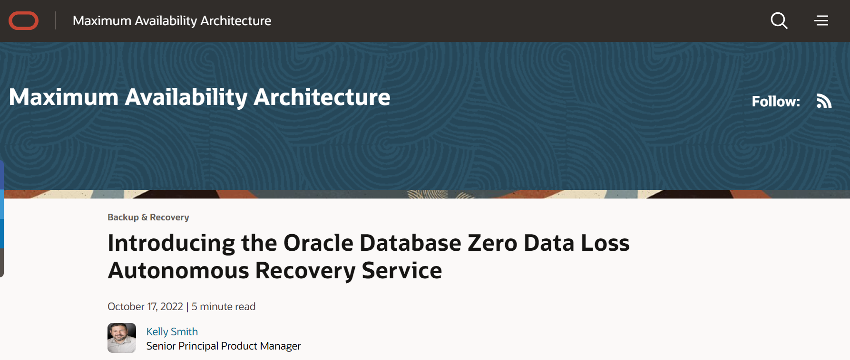
Zero Data Loss as a Service on OCI
Click Here

Slide 26
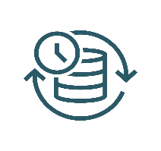
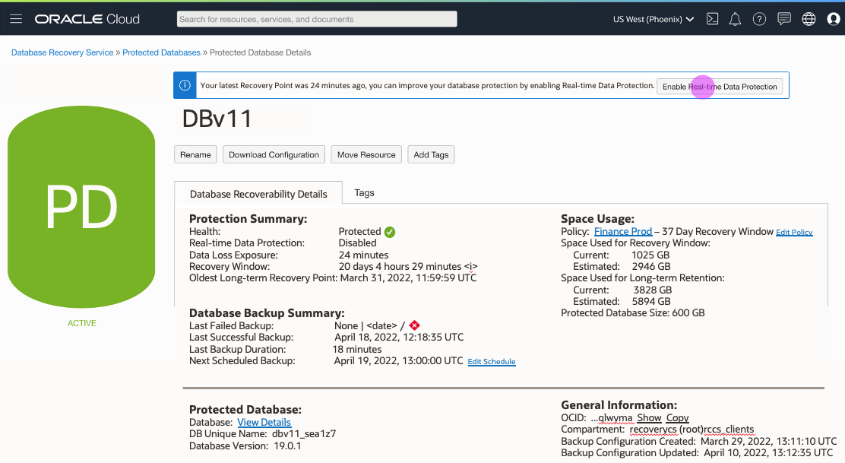
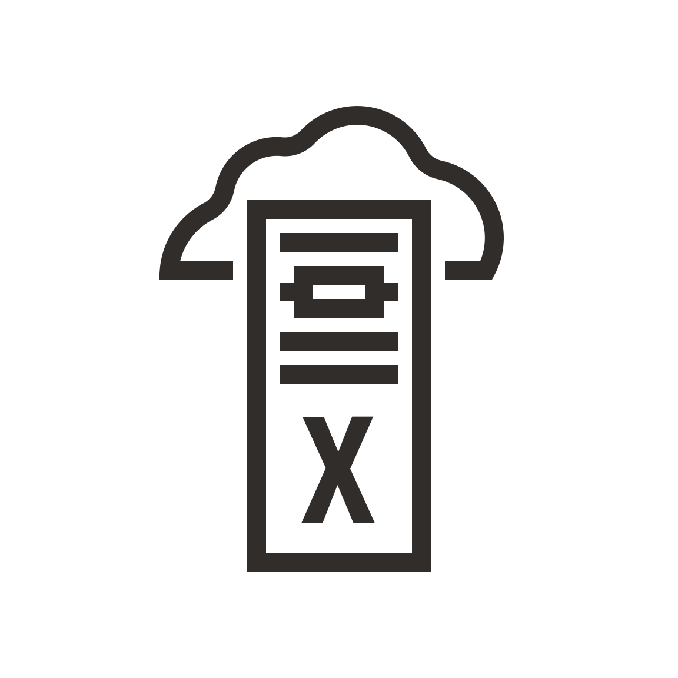
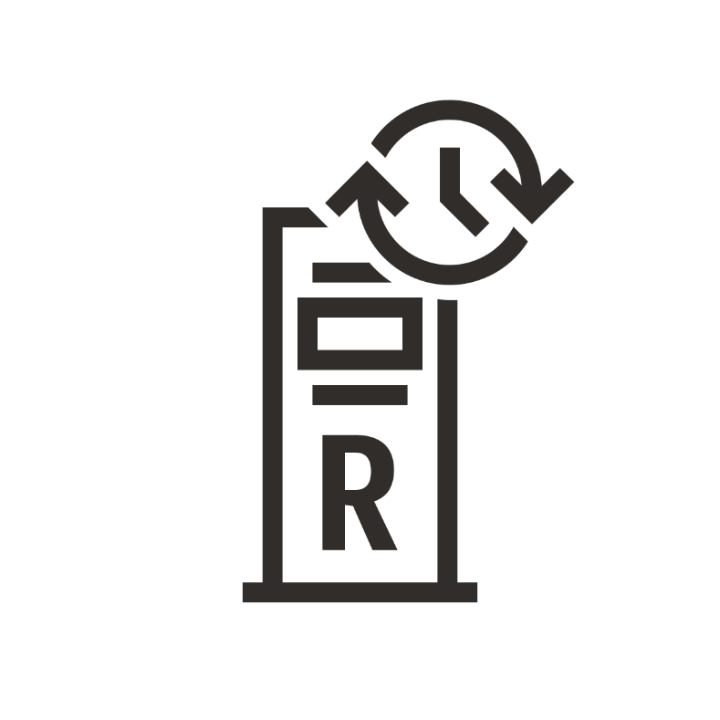




Oracle Database Zero Data Loss Autonomous Recovery Service
A fully managed, automated service for continuously protecting Oracle databases in OCI
OCI native administration
Ransomware resiliency
Automatic and mandatory encryption to help prevent data theft
Safeguards backups with enforced 14-day retention
Optimizes backups in the background for fast recovery with zero data loss
Operational efficiency
No more weekly full backups – eliminates production database overhead
Shorter backup windows with incremental forever strategy
Zero-impact database recovery validation for every backup
Cloud simplicity
Quickly configure database protection at scale with zero data loss
Control costs with database-specific backup consumption metrics
Gain deep data protection insights with granular recovery health dashboard
Using proven Recovery Appliance technology
Real-time data protection option
Exadata
Database Service
Zero Data Loss Autonomous
Recovery Service
Enterprise
Database Service
Automated
Compressed
Encrypted
Autonomous
Database
- Dedicated
Incremental
forever backup
Standard
Database Service
Encryption keys are owned by and managed with the database

Slide 27


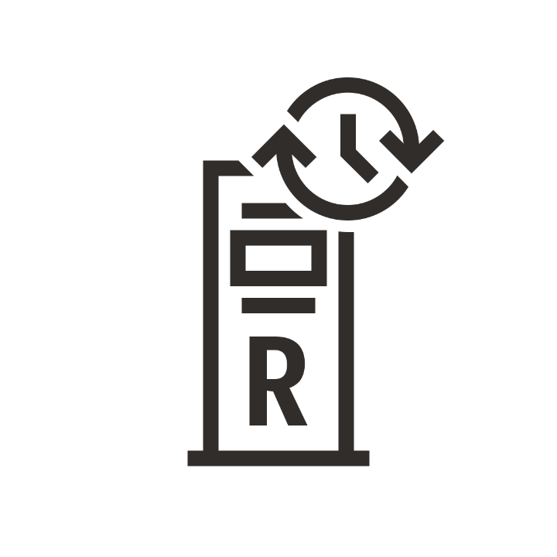
Recovery Service eliminates weekly full backups
Incremental-forever backups reduce backup overhead on production database services
Autonomous Database - Dedicated
Exadata Database Service
Day 0 Full
Day 1 Incr
Day N Incr
01001010110 10010101101
01001010010 10010101100
Enterprise Database Service
01001010110
01001010110
Time Machine
Standard Database Service
Incremental forever backups
of protected databases
Recovery Appliance Delta Push (What it Does)
Incremental forever backups
stored on Recovery Service

Slide 28
Recovery Service simplifies database restores
Creation of virtual full backups eliminates multiple incremental restore & apply cycles
Request: January 9, 2022
Day ‘N’ Virtual Full Backup
Restore Database To Day ‘N’ at 14:53.12
Autonomous Database - Dedicated
Exadata Database Service
Day 0 Full
Day 1 Incr
Day N Incr
Enterprise Database Service
Time Machine
Standard Database Service
Incremental forever backups
of protected databases
Recovery Appliance Delta Push (What it Does)
Incremental forever backups
stored on Recovery Service

Slide 29








Recovery Service continuously protects Oracle databases
Real-time protection of database changes increases resiliency with point-in-time recovery
Protected databases
Real-time logs
Purchase/Sale
Supply chain
Delivery
Payroll
HR update
Autonomous Database - Dedicated
Exadata Database Service
Day 0 Full
Day 1 Incr
Day N Incr
Enterprise Database Service
Time Machine
Standard Database Service
Incremental forever backups
of protected databases
Recovery Appliance Delta Push (What it Does)
Incremental forever backups
stored on Recovery Service

Slide 30
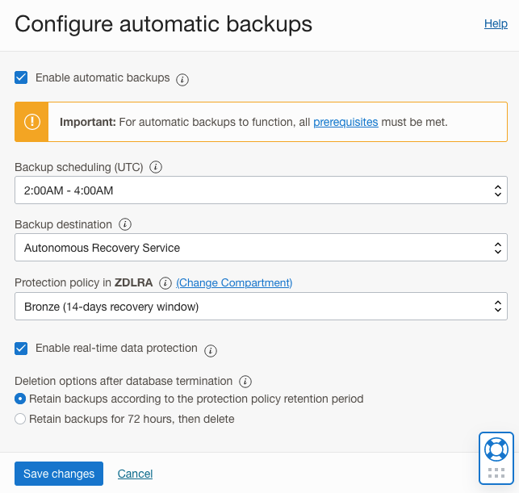
Recovery Service is easy to set up and use
Protect Oracle databases with less then 5 clicks in the OCI console
A fully managed OCI service with a simple UI
Enable automatic backups
Schedule daily incremental backups to meet your business schedule
Select Autonomous Recovery Service
Select protection window of 14 to 95 days
Enable real-time protection

Slide 31
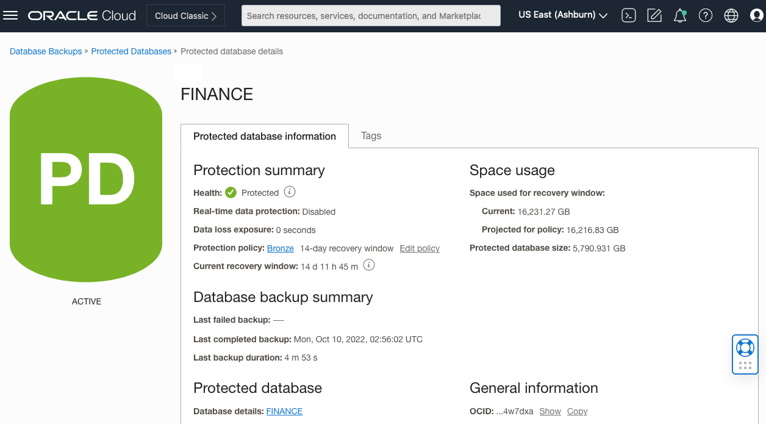
Recovery Service protects against unauthorized access
Built-in security and resiliency help safeguard mission-critical data
Encryption is mandatory
Non-encrypted databases are rejected
Keys are never stored in the Recovery Service
Access and management controls
No direct user access to storage – backup only
Access granted per protected database
14-day minimum retention enables recovery from human error or malicious internal actors
Resilient operations
Fault-tolerant across all infrastructure components
Highly available across Availability Domains and Fault Domain
Load balanced within a region

Slide 32
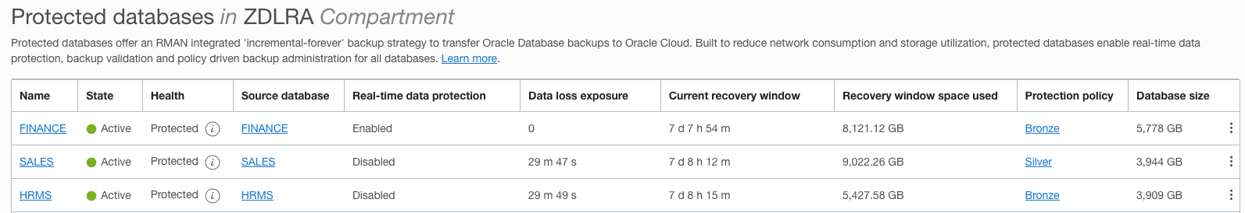
Recovery Service provides insights into backup health and operations
Built-in dashboards and tools simplify reporting and planning
Continuous monitoring of potential business risks
Data loss exposure
Recovery window
Critical data for operational planning
Capacity usage
Protection policy
Real-time protection and data loss exposure
Recovery window and capacity used
Protection policy

Slide 33
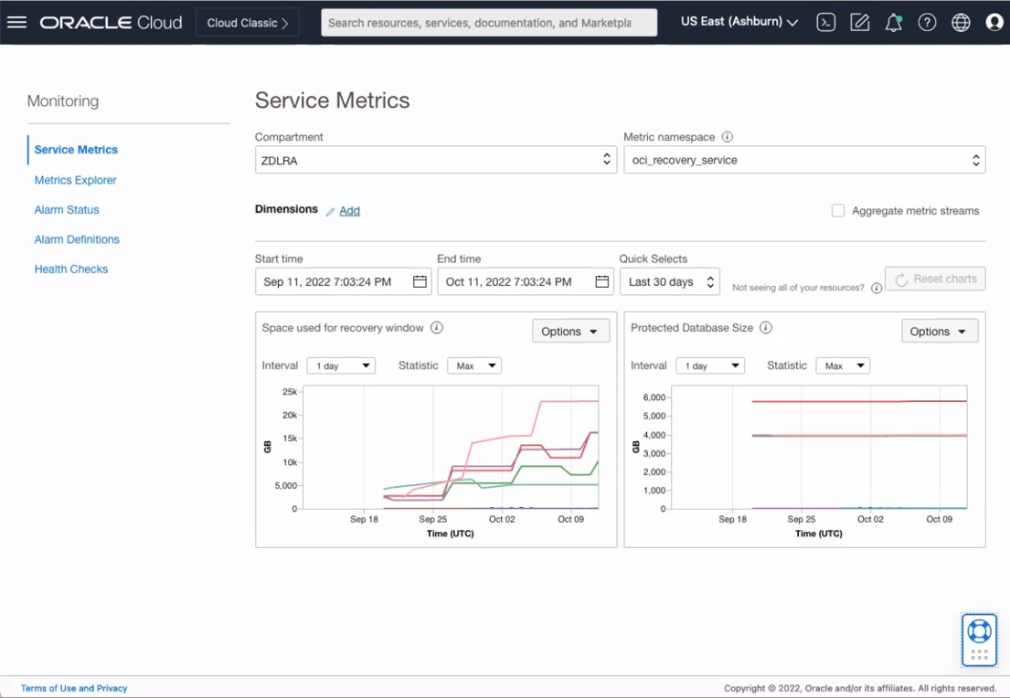
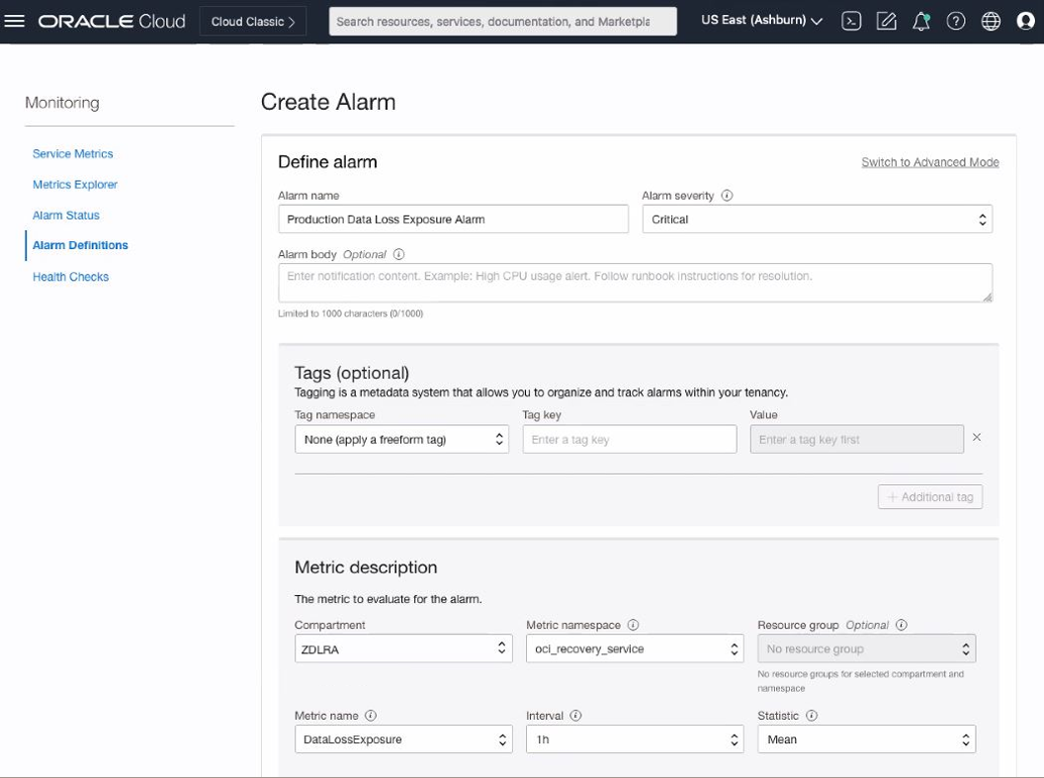
Recovery Service integrates with OCI observability and management
Comprehensive visibility across the full cloud stack
Integration with OCI Metrics Explorer provides common access to critical information
Alarms and notifications are created within OCI for consistent monitoring and management

Slide 34
Exadata Cloud backup and restore tools

Slide 35

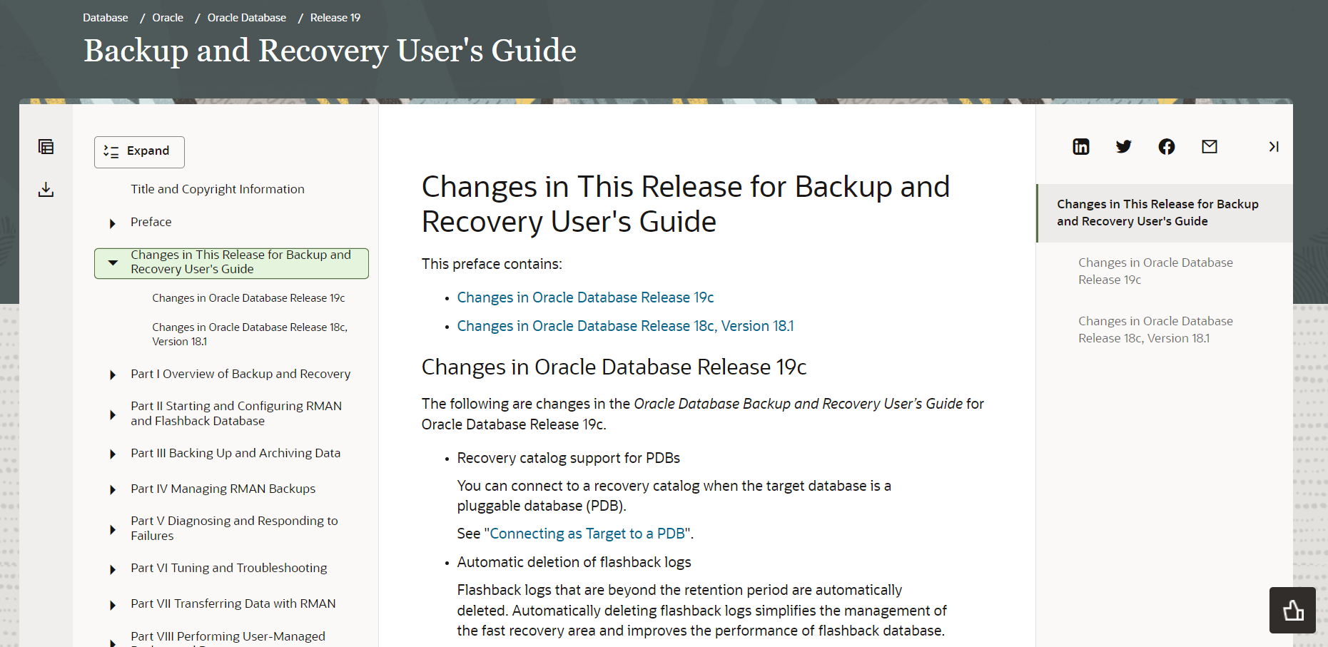
Rman Database Backup and Recover 19c User’s Guide
Click Here

Slide 36
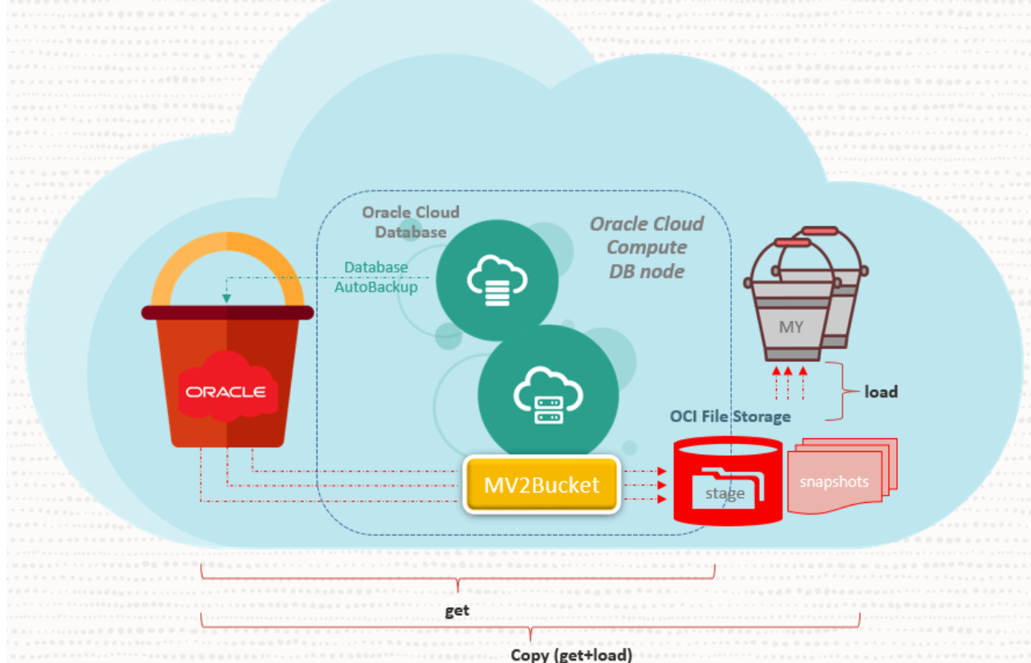
(OCI) mv2bucket - Oracle Managed Bucket Content Manager MOS Note: 2723911.1

Slide 37











Exadata Cloud Services: User Configured Backups
RMAN backup via dbaascli and bkup_api
RMAN
 | SCHEDULING | No Control Plane (Cloud Console) backup scheduling Scheduled by cron job, runs from first node Automatic archivelog backup every 30 minutes Ability to change default backup time and L0 backup day
 | DESTINATION | Customer-created bucket (fully controlled by the customer, including replication) No support for archive storage
 | REPLICAS | Option to set up cross-region backup replication
 | CREDENTIALS | Customer responsible for password rotation
 | WALLET | TDE wallet backed up, but not its password or the autologin wallet
 | RESTORE | Restore CDB and PDB capabilities No duplicate on the same host via bkup_api
 | FAILOVER | Backup initiated on a specific node. Failure of the node will fail the current backup api call.
 | STANDBY | No backup for standby database but can be configured to backup once role is primary
 | CHARGING | For object storage space and number of requests (not for the backup module)

Slide 38
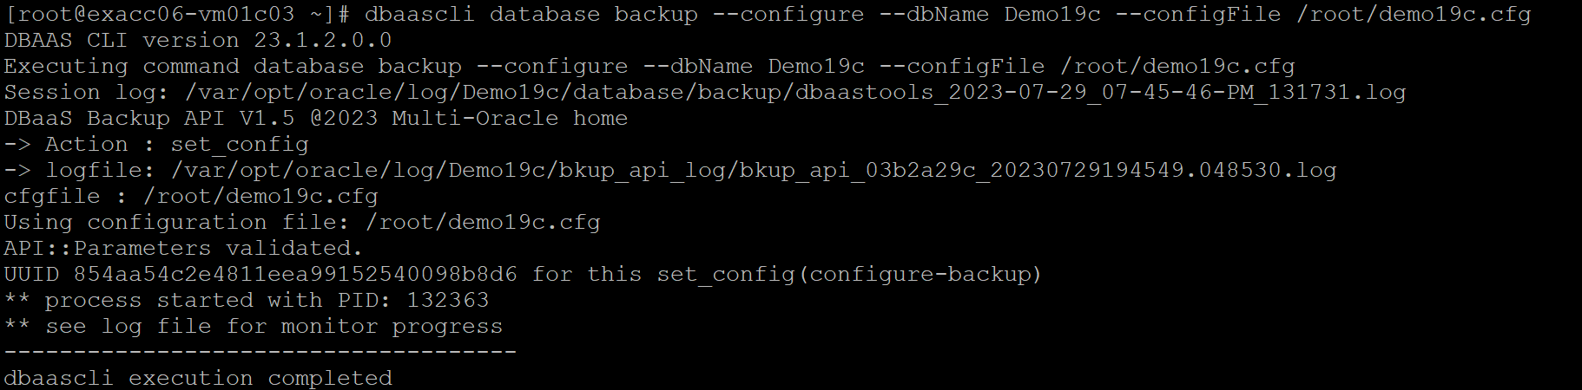
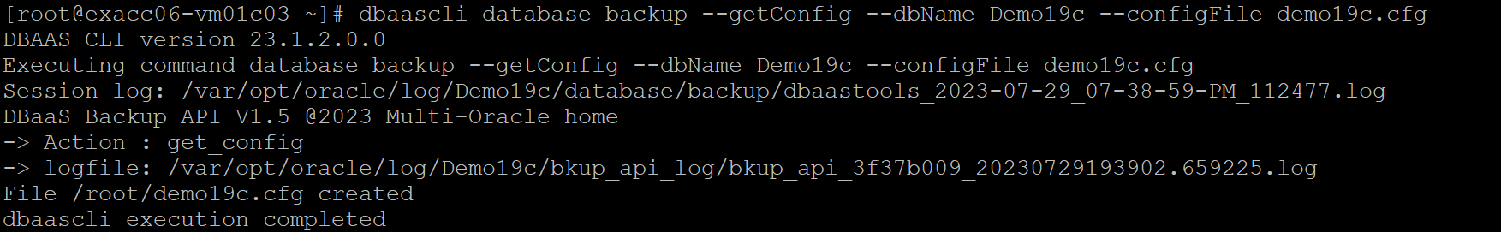
Dbaascli Creating initial configuration file

Slide 39

Dbaascli most used Database Backup commands
# dbaascli database backup --dbname
--list
[--backupType <value>]
--start
[--level0] [--level1]
[--archival --tag <value>]
[--archivelog]
--delete --backupTag <value>
--status --uuid <value>
--getBackupReport
[--tag <value>]
[--latest]
--showHistory
--configure
--validate [--untilTime <value>]
--getConfig [--configFile <value>]
Click Here

Slide 40

Dbaascli most used pdb backup commands
# dbaascli pdb backup --pdbName <value> --dbname <value>
--start
[--level1]
[--archival --tag <value>]
--delete --backupTag <value>
--status --uuid <value>
--getBackupReport
--list [--json <value>
Click Here

Slide 41

Dbaascli most used Databases recovery commands
# dbaascli database recover –dbname <value>
--start
[--untilTime <value>]
[--untilSCN <value>]
[--latest]
[--tag <value>]
--status --uuid <value>
Click Here

Slide 42

Dbaascli most used Databases recovery commands
# dbaascli pdb recover --pdbName <value> --dbname <value>
--start
[--untilTime <value>]
[--untilSCN <value>]
[--latest]
[--tag <value>]
--status --uuid <value>
Click Here

Slide 43
Exadata C@C Network

Slide 44

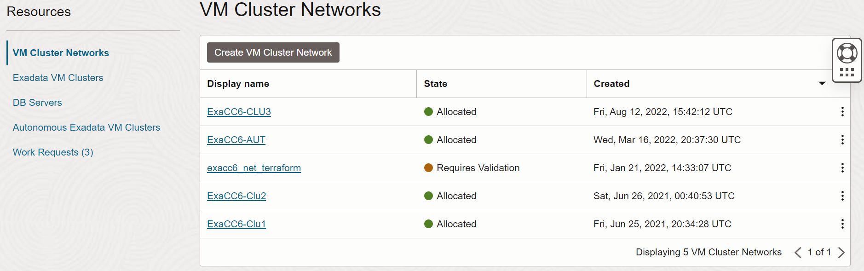
Exadata Cloud at Customer | VM Cluster Network
Click Here

Slide 45
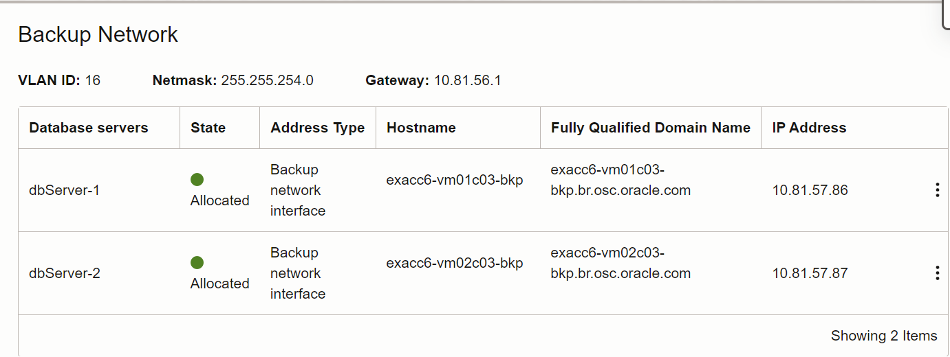
Exadata Cloud at Customer | Backup Network

Slide 46
Demo Time

Slide 47

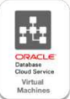
Demo 1 – OCI backup provisioning
Configuring Automatic backup Via OCI Console
Restore Database Using OCI Console
Demo 2 – Backing up via dbaascli
Backing up Database and PDB’s using dbaascli
Backing up TDE encryption key using dbaascli
Checking Database and PDB’s backup history using dbaascli
Demo 3 – Tuning Rman Backup
Enabling Oracle Rman Block Change Tracking
Run incremental backup level 1
Run the same incremental level 1 again
Compare both times

Slide 48
Resources

Slide 49

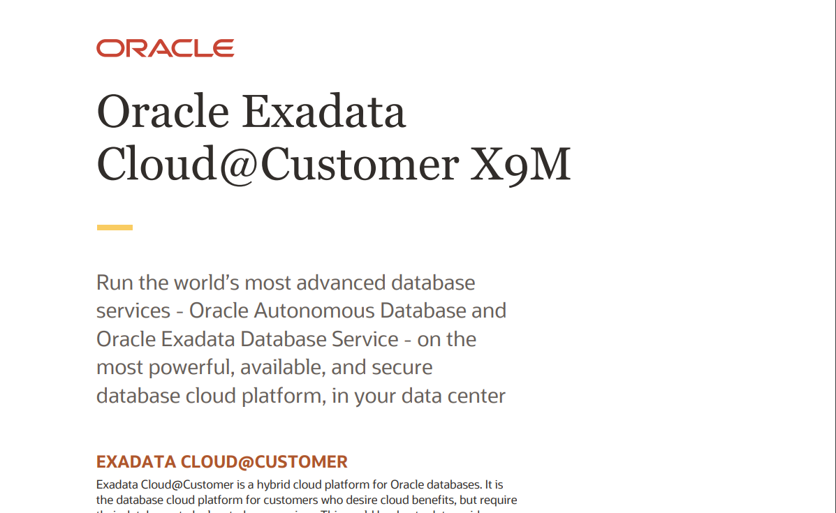
Exadata Cloud at Customer X9M Data Sheet
Click Here

Slide 50

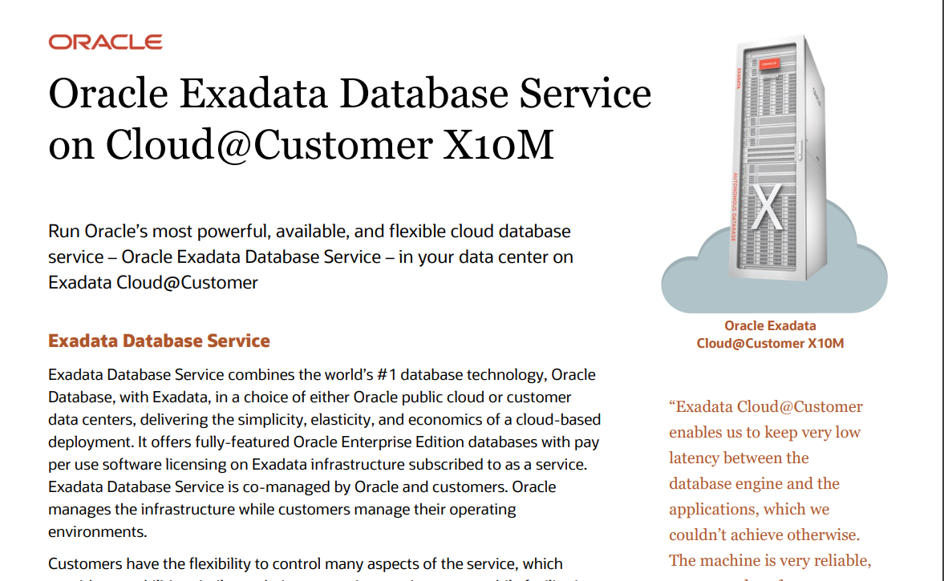
Exadata Cloud at Customer X10M Data Sheet
Click Here

Slide 51

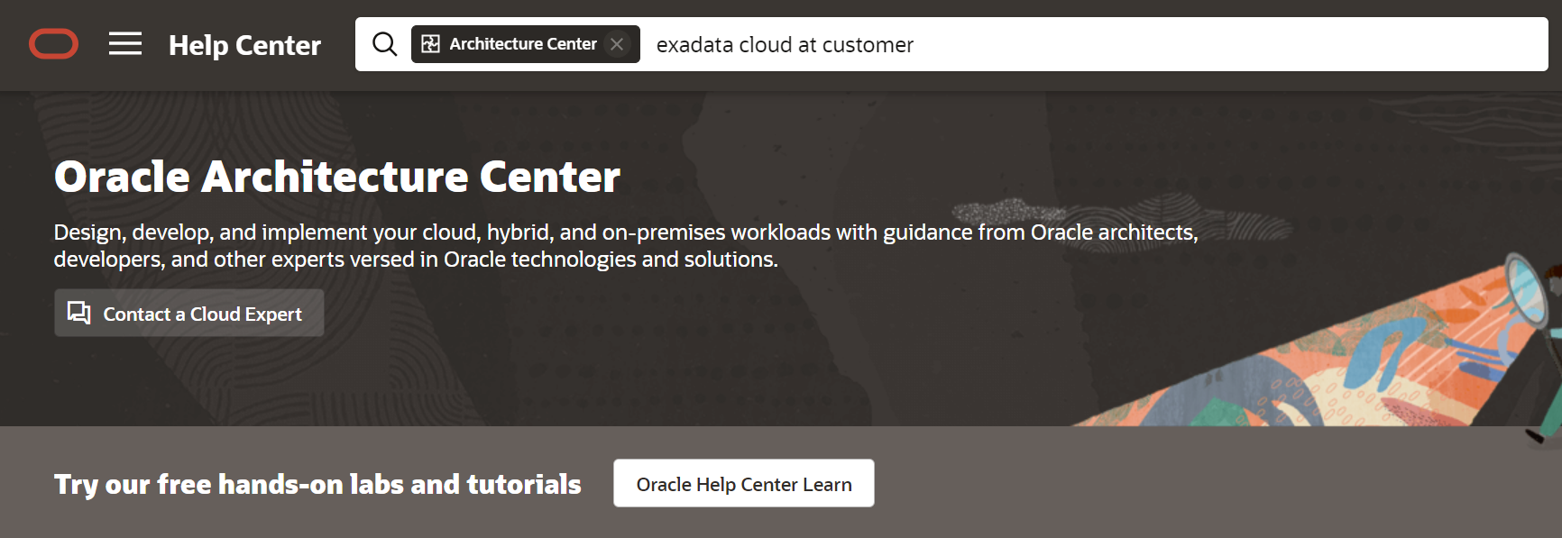
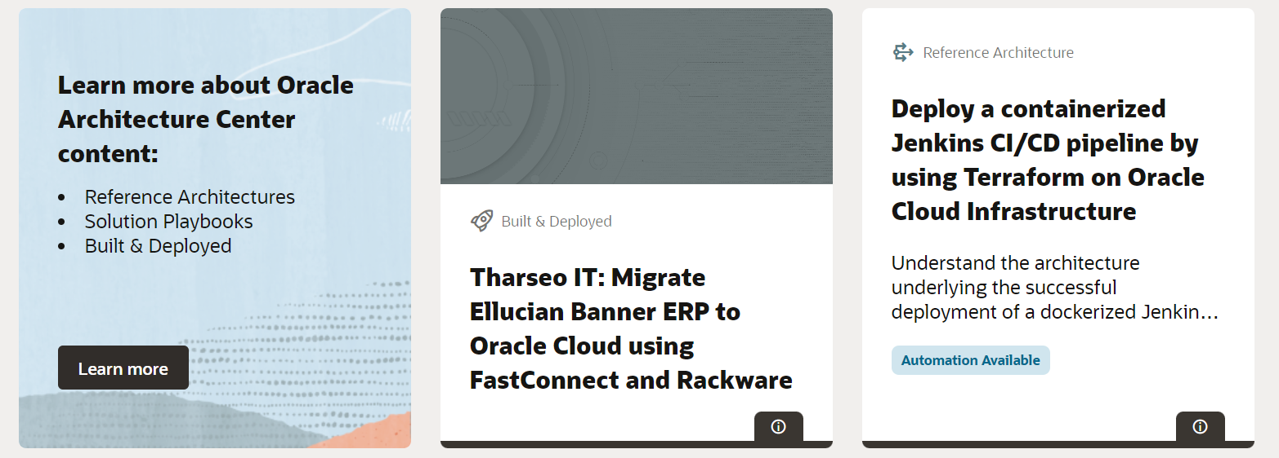
Exadata Cloud Oracle on Architecture Center
Click here

Slide 52

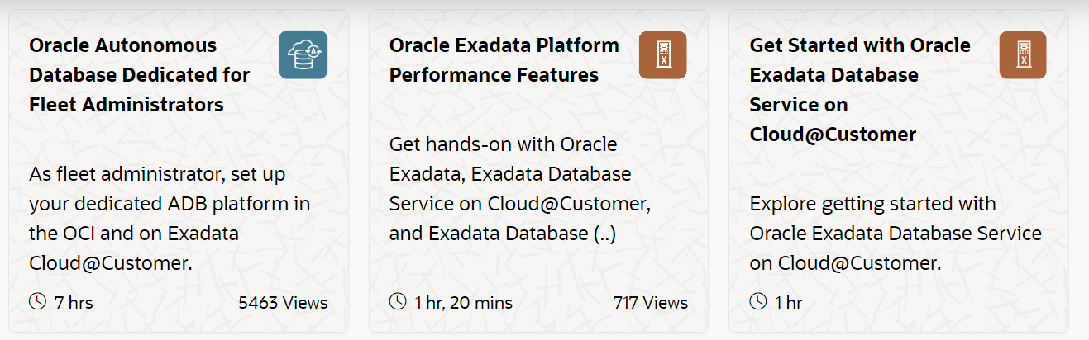
Exadata Cloud on Oracle Live Labs
Click Here

Slide 53

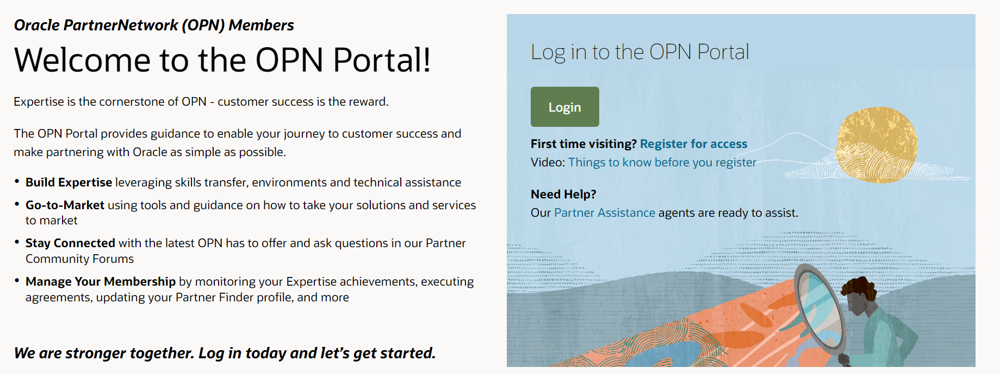
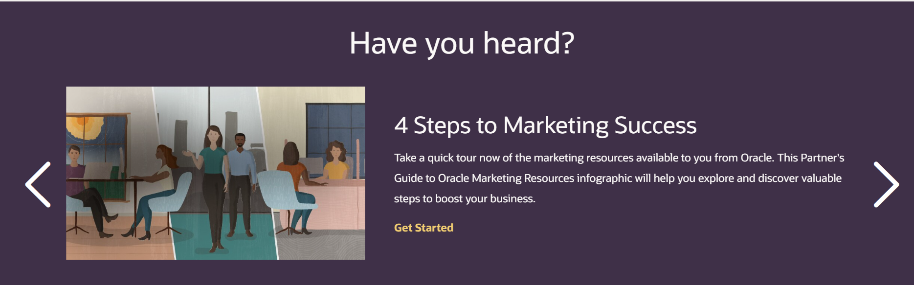
OPN Web Page
Click here

Slide 54


Stay Connected with the Latin America Partner Community! Information, collaboration and training all in a single spot.
The LAD Partner Community is a space dedicated to our partners in Latin America, where you can find information and stay up to date on what OPN has to offer.
In the Community, you will find all the information that we communicate to our ecosystem by email.
Explore Categories: organized by grouping publications on a same topic;
Access the Recent Discussions tab to check the latest posts published;
Take part in Groups and interact with Oracle Experts and other partners;
Recordings.
Important: An Oracle SSO account is required to access the Community and other OPN resources. If you don't have this account yet, access this link or the QR code below.
Access the Community:
Create your SSO account:

Slide 55


Thank You ☺
Questions / Feedback / Training Suggestions
alexandre.af.fagundes@oracle.com
marcel.lamarca@oracle.com
Ask for help ☺

